Slide 1
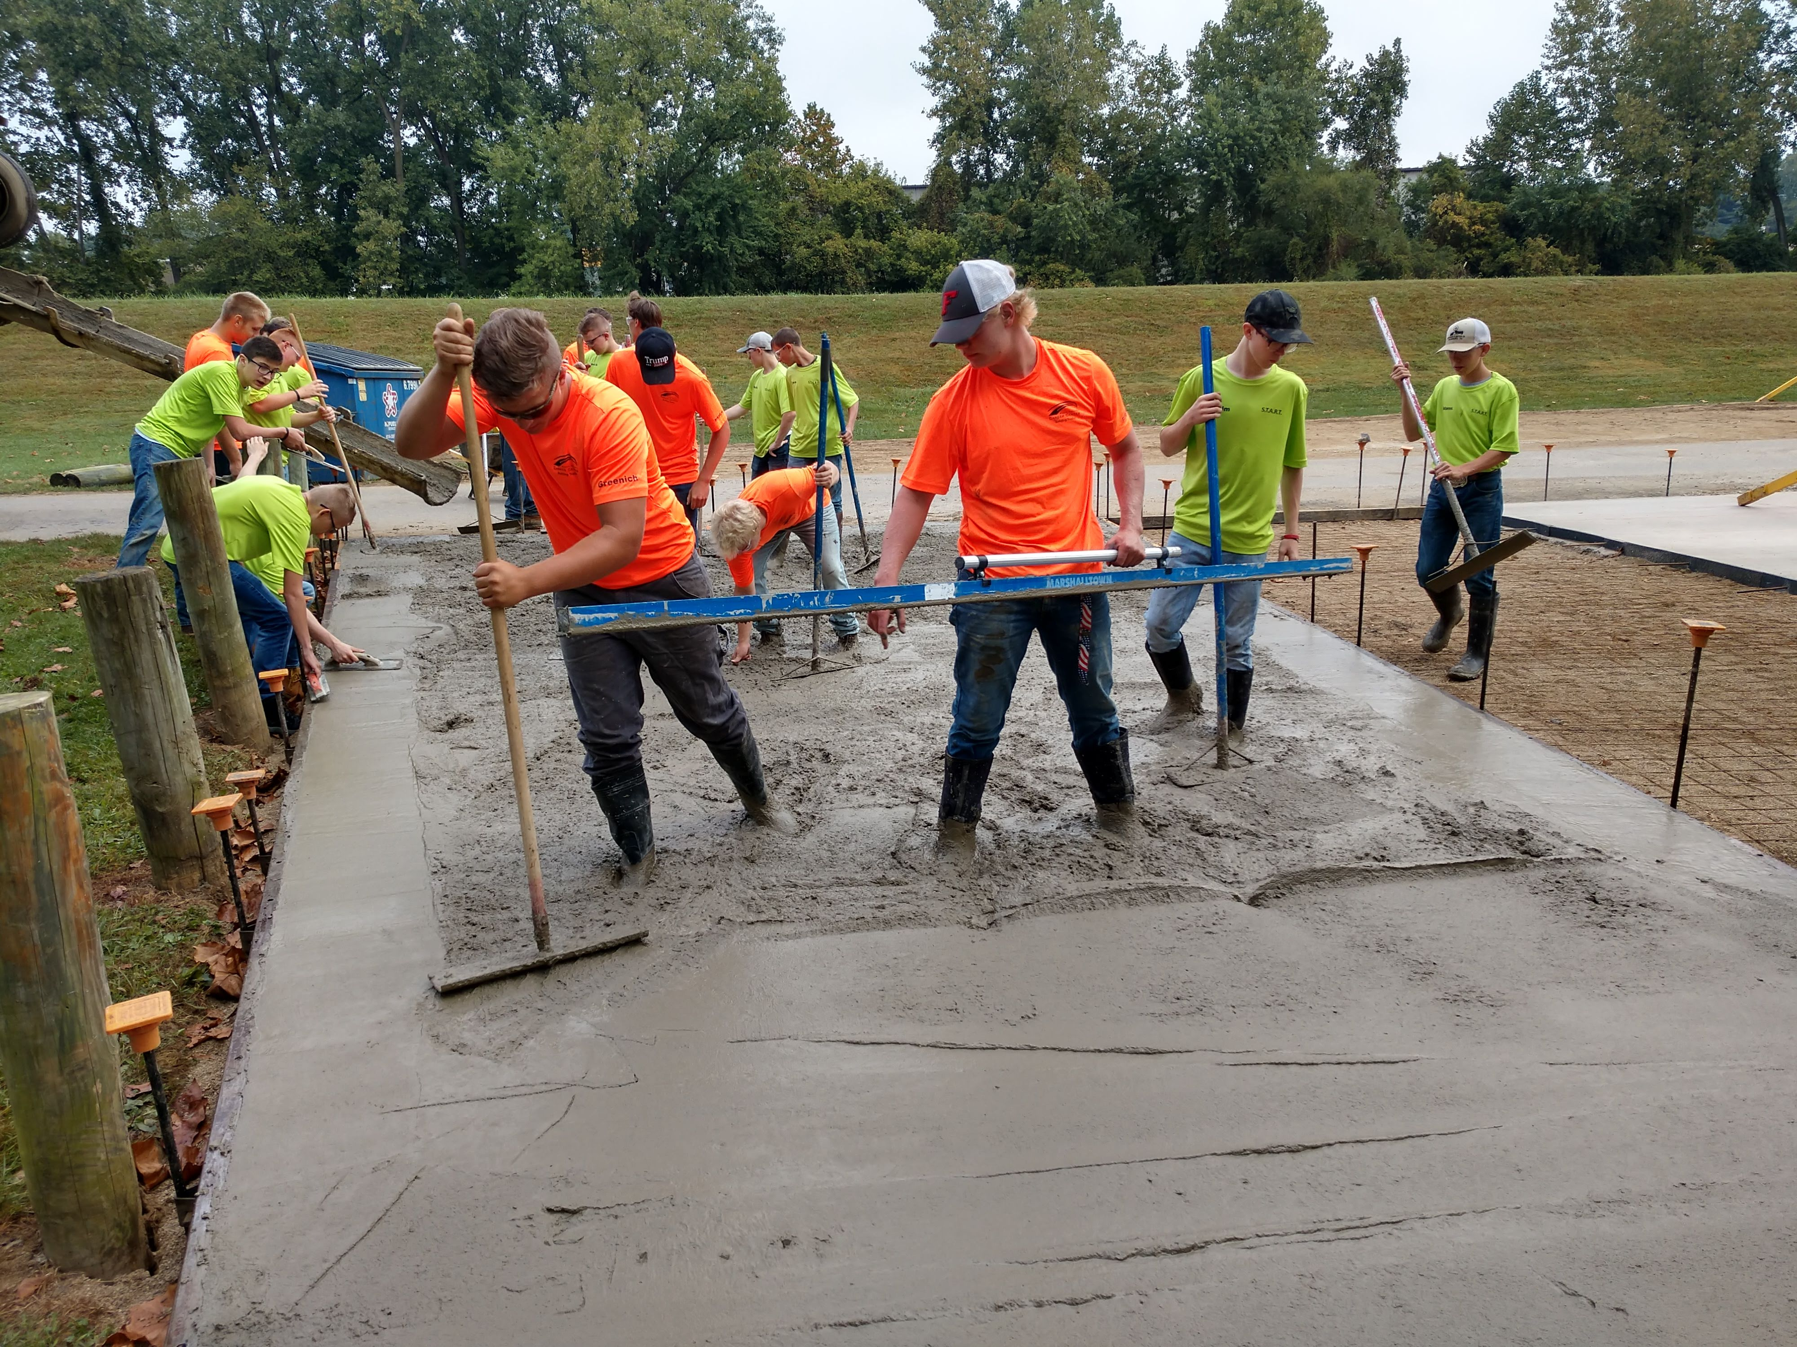
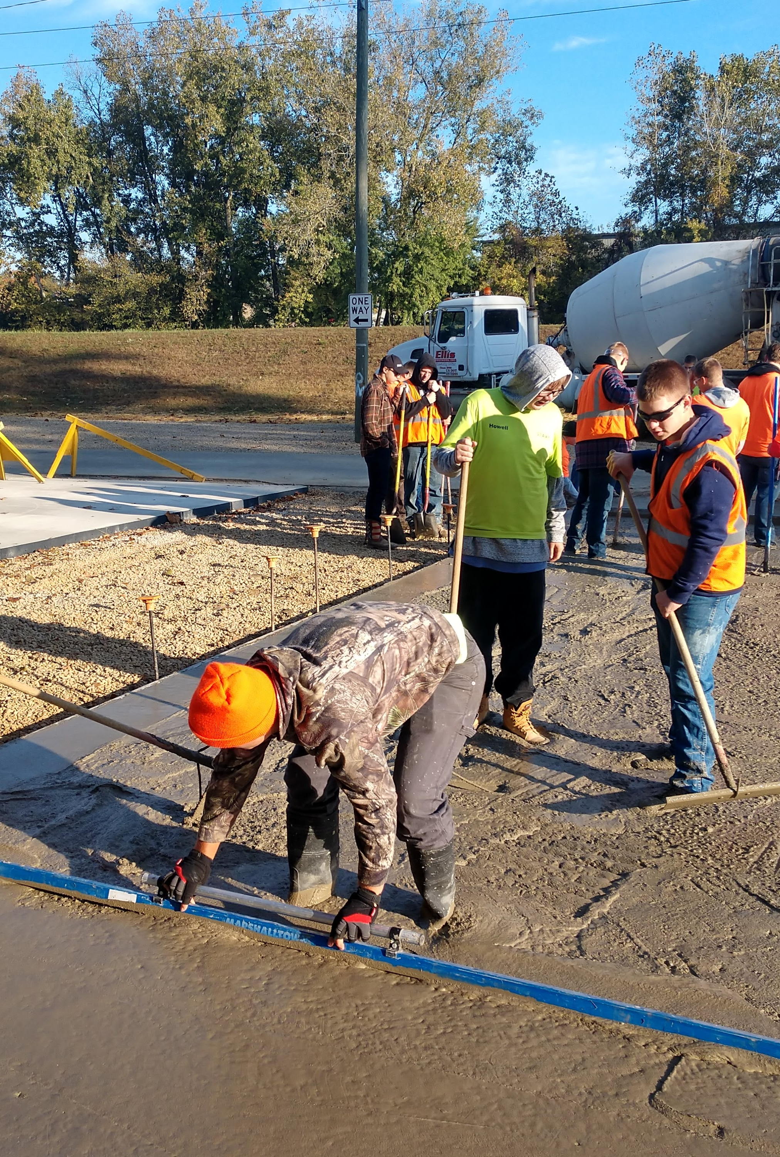
Train One for the Trades
Are you committed?

Slide 2
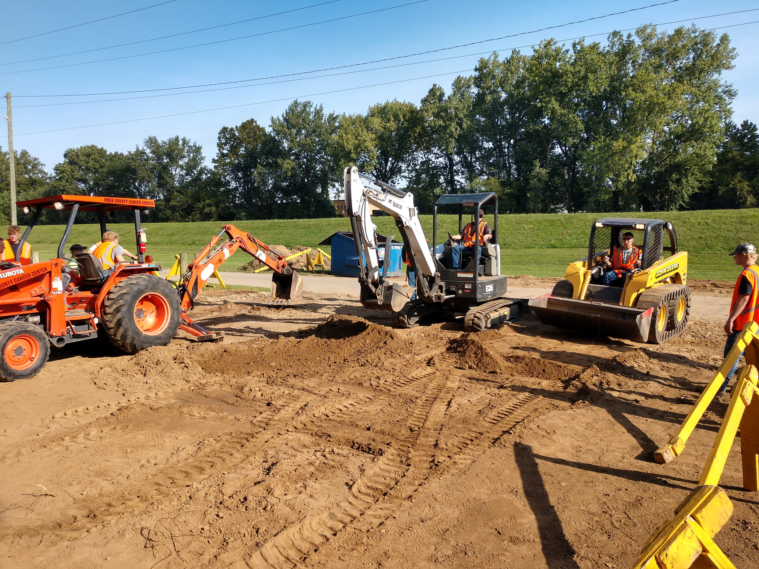
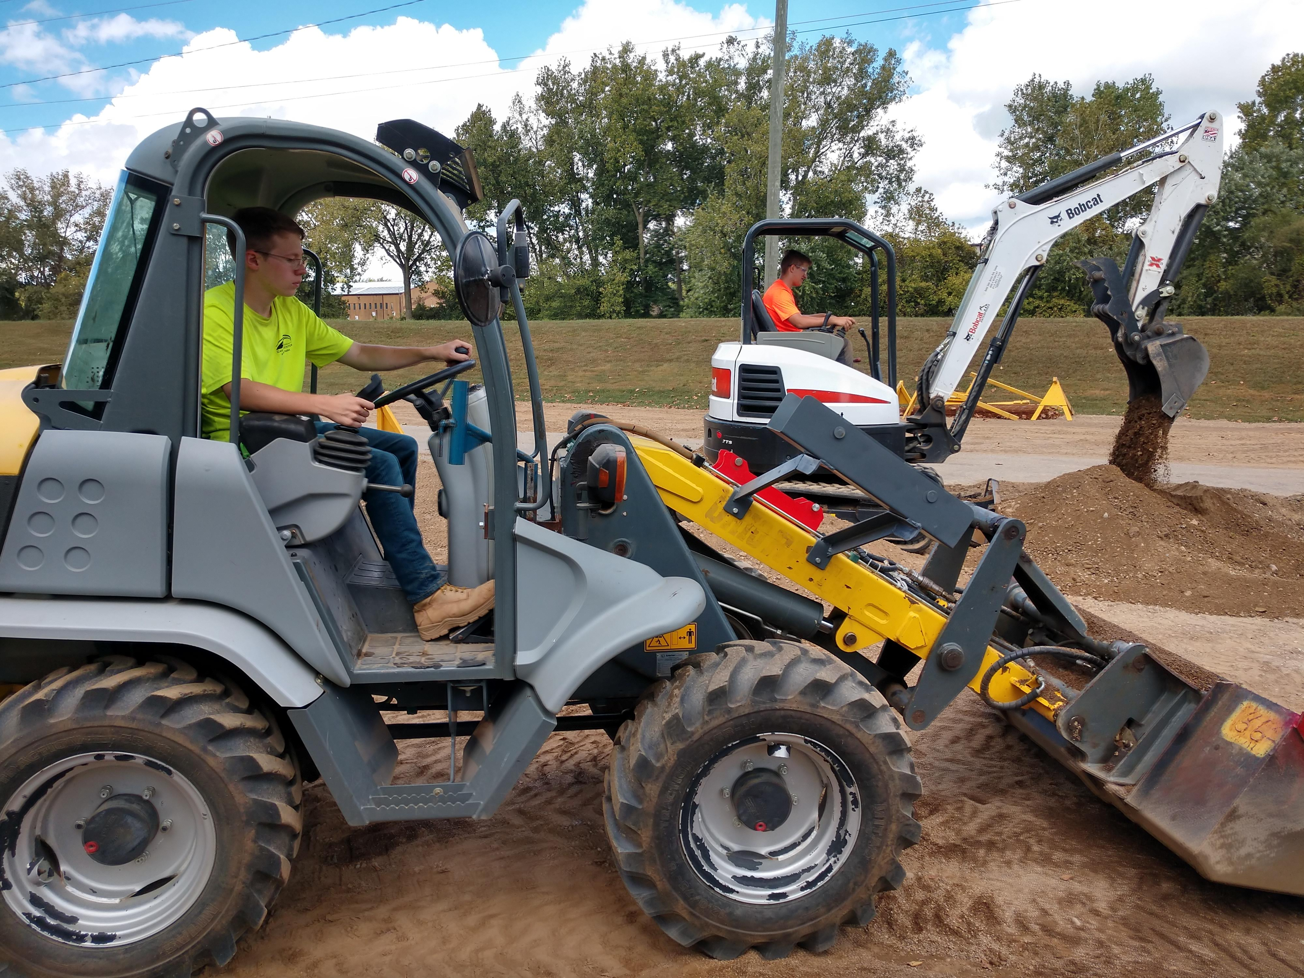
Building Trades
Concrete
Masonry
Carpentry
Heavy Equipment Operation
Certifications

Slide 3
Career Tech Generation Z
They have to feel respected by their employer
Their work has to be meaningful
Work life balance is key
Texting
They want to be paid what they are worth

Slide 4
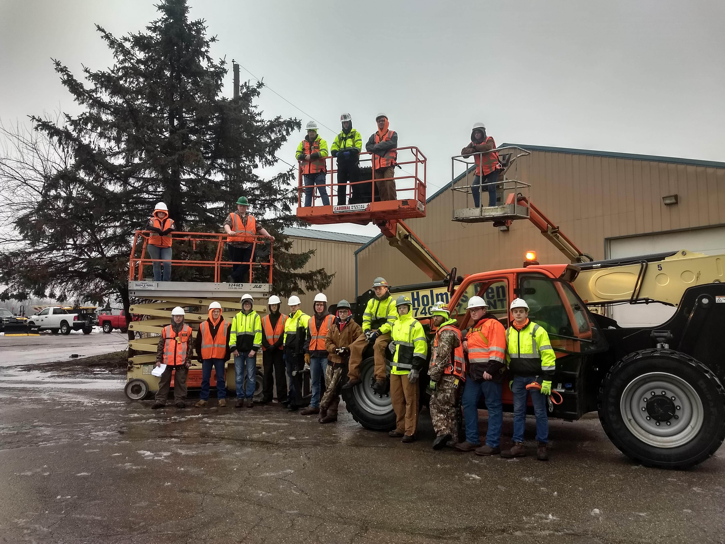

Slide 5
Generation Z
Frequent raises in the first year
Most do not expect any paid vacation in the first year but all expected paid holidays
Nearly every student would choose a raise over vacation
Benefits were of little value when considering an employer but when asked what would make them stay beyond the first year benefits ranked first

Slide 6
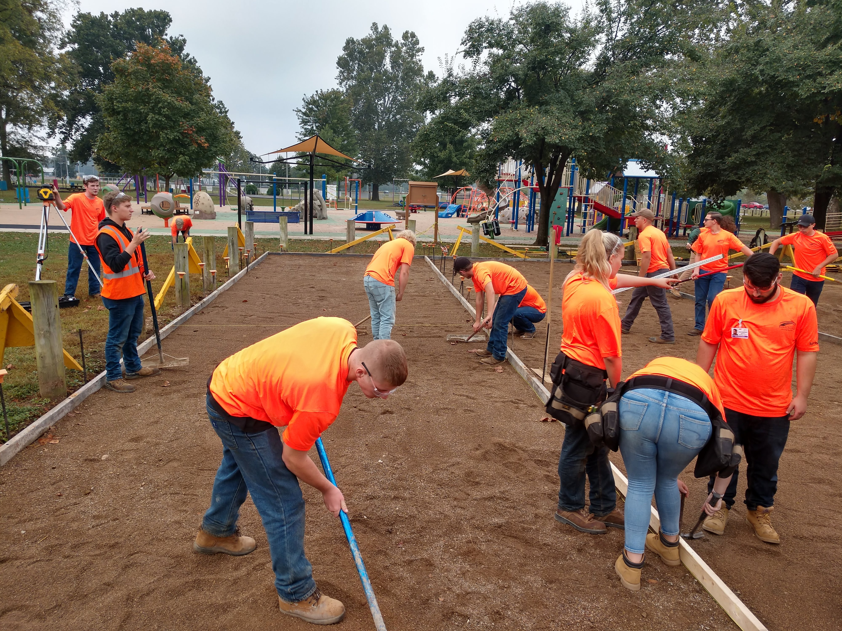

Slide 7
Are you invested into Career Tech?
Training
Advisory Boards
Presentations
Attend Events
Open House/Site Visit
BT Elite

Slide 8
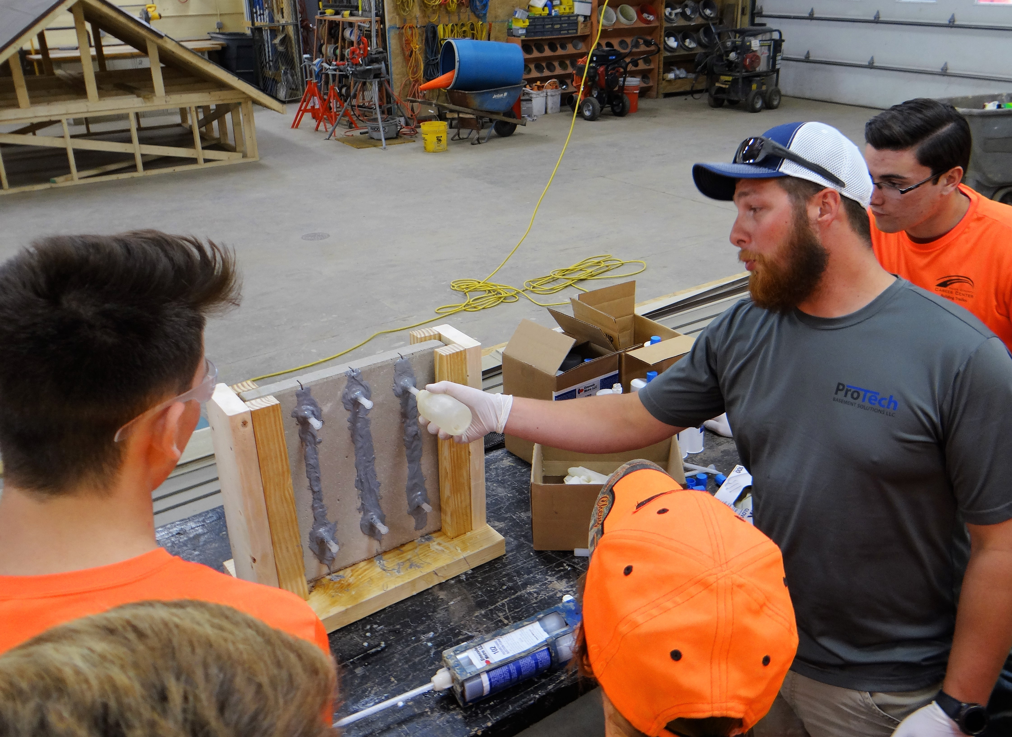
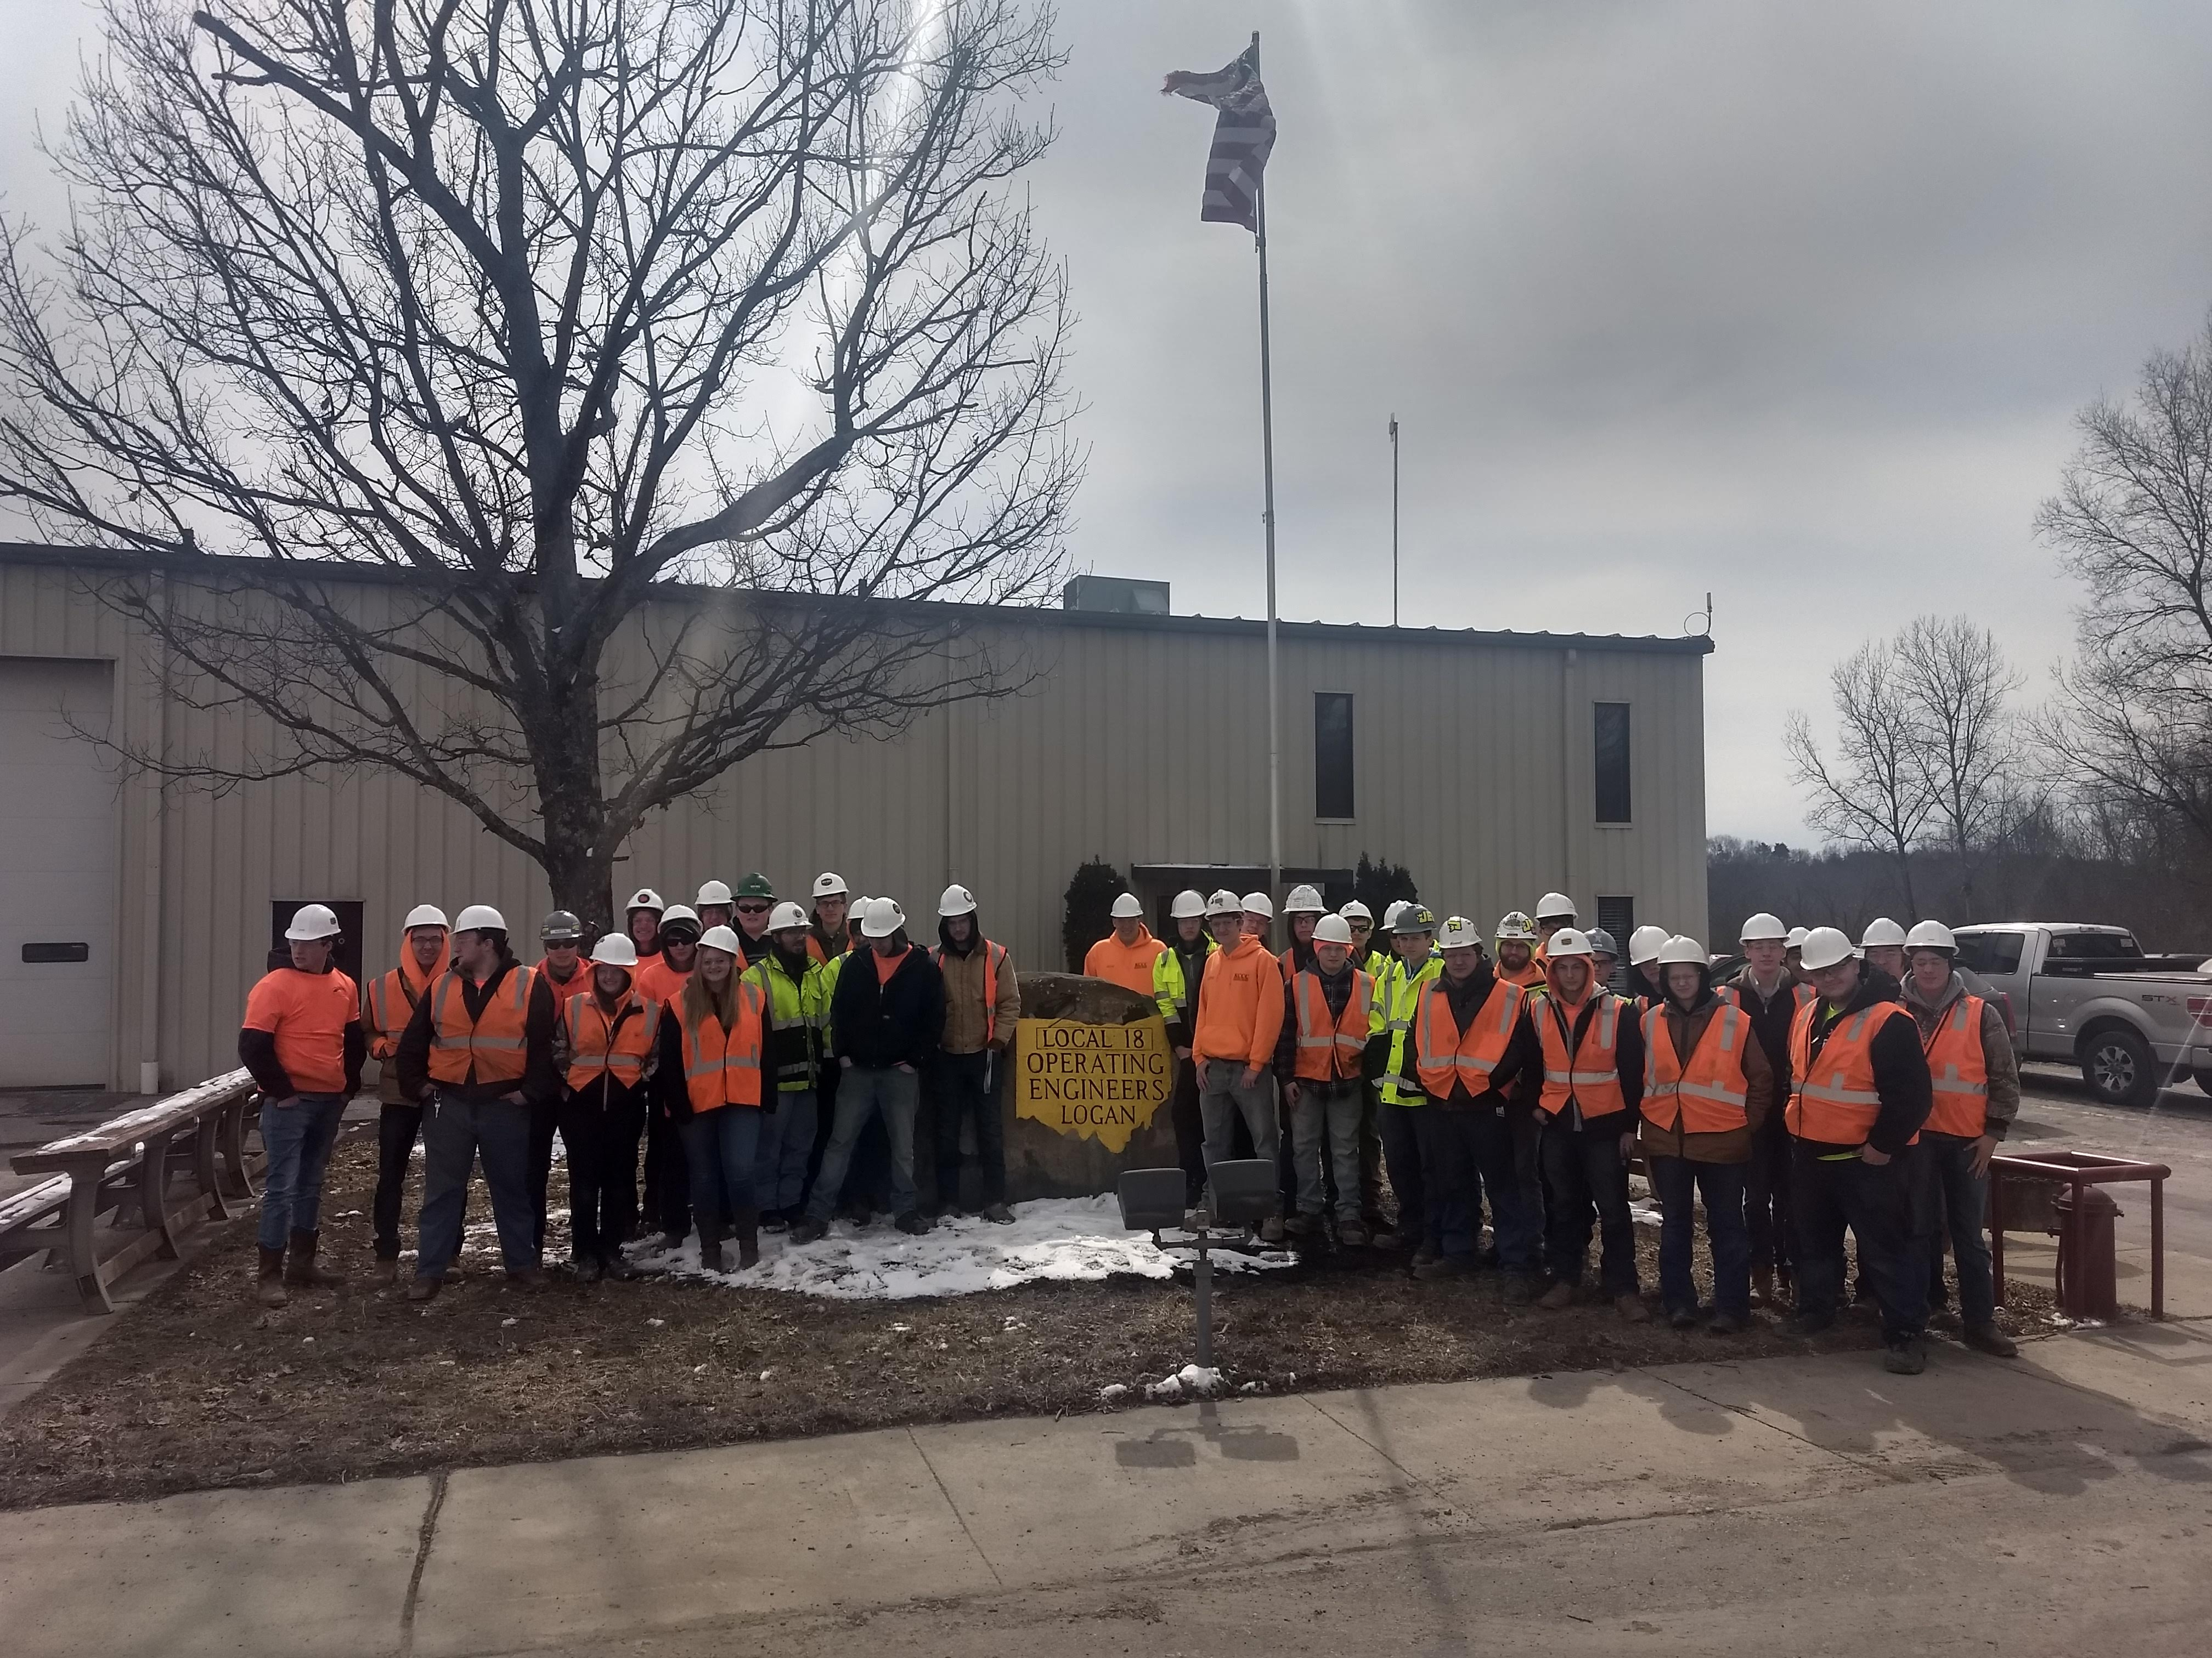

Slide 9
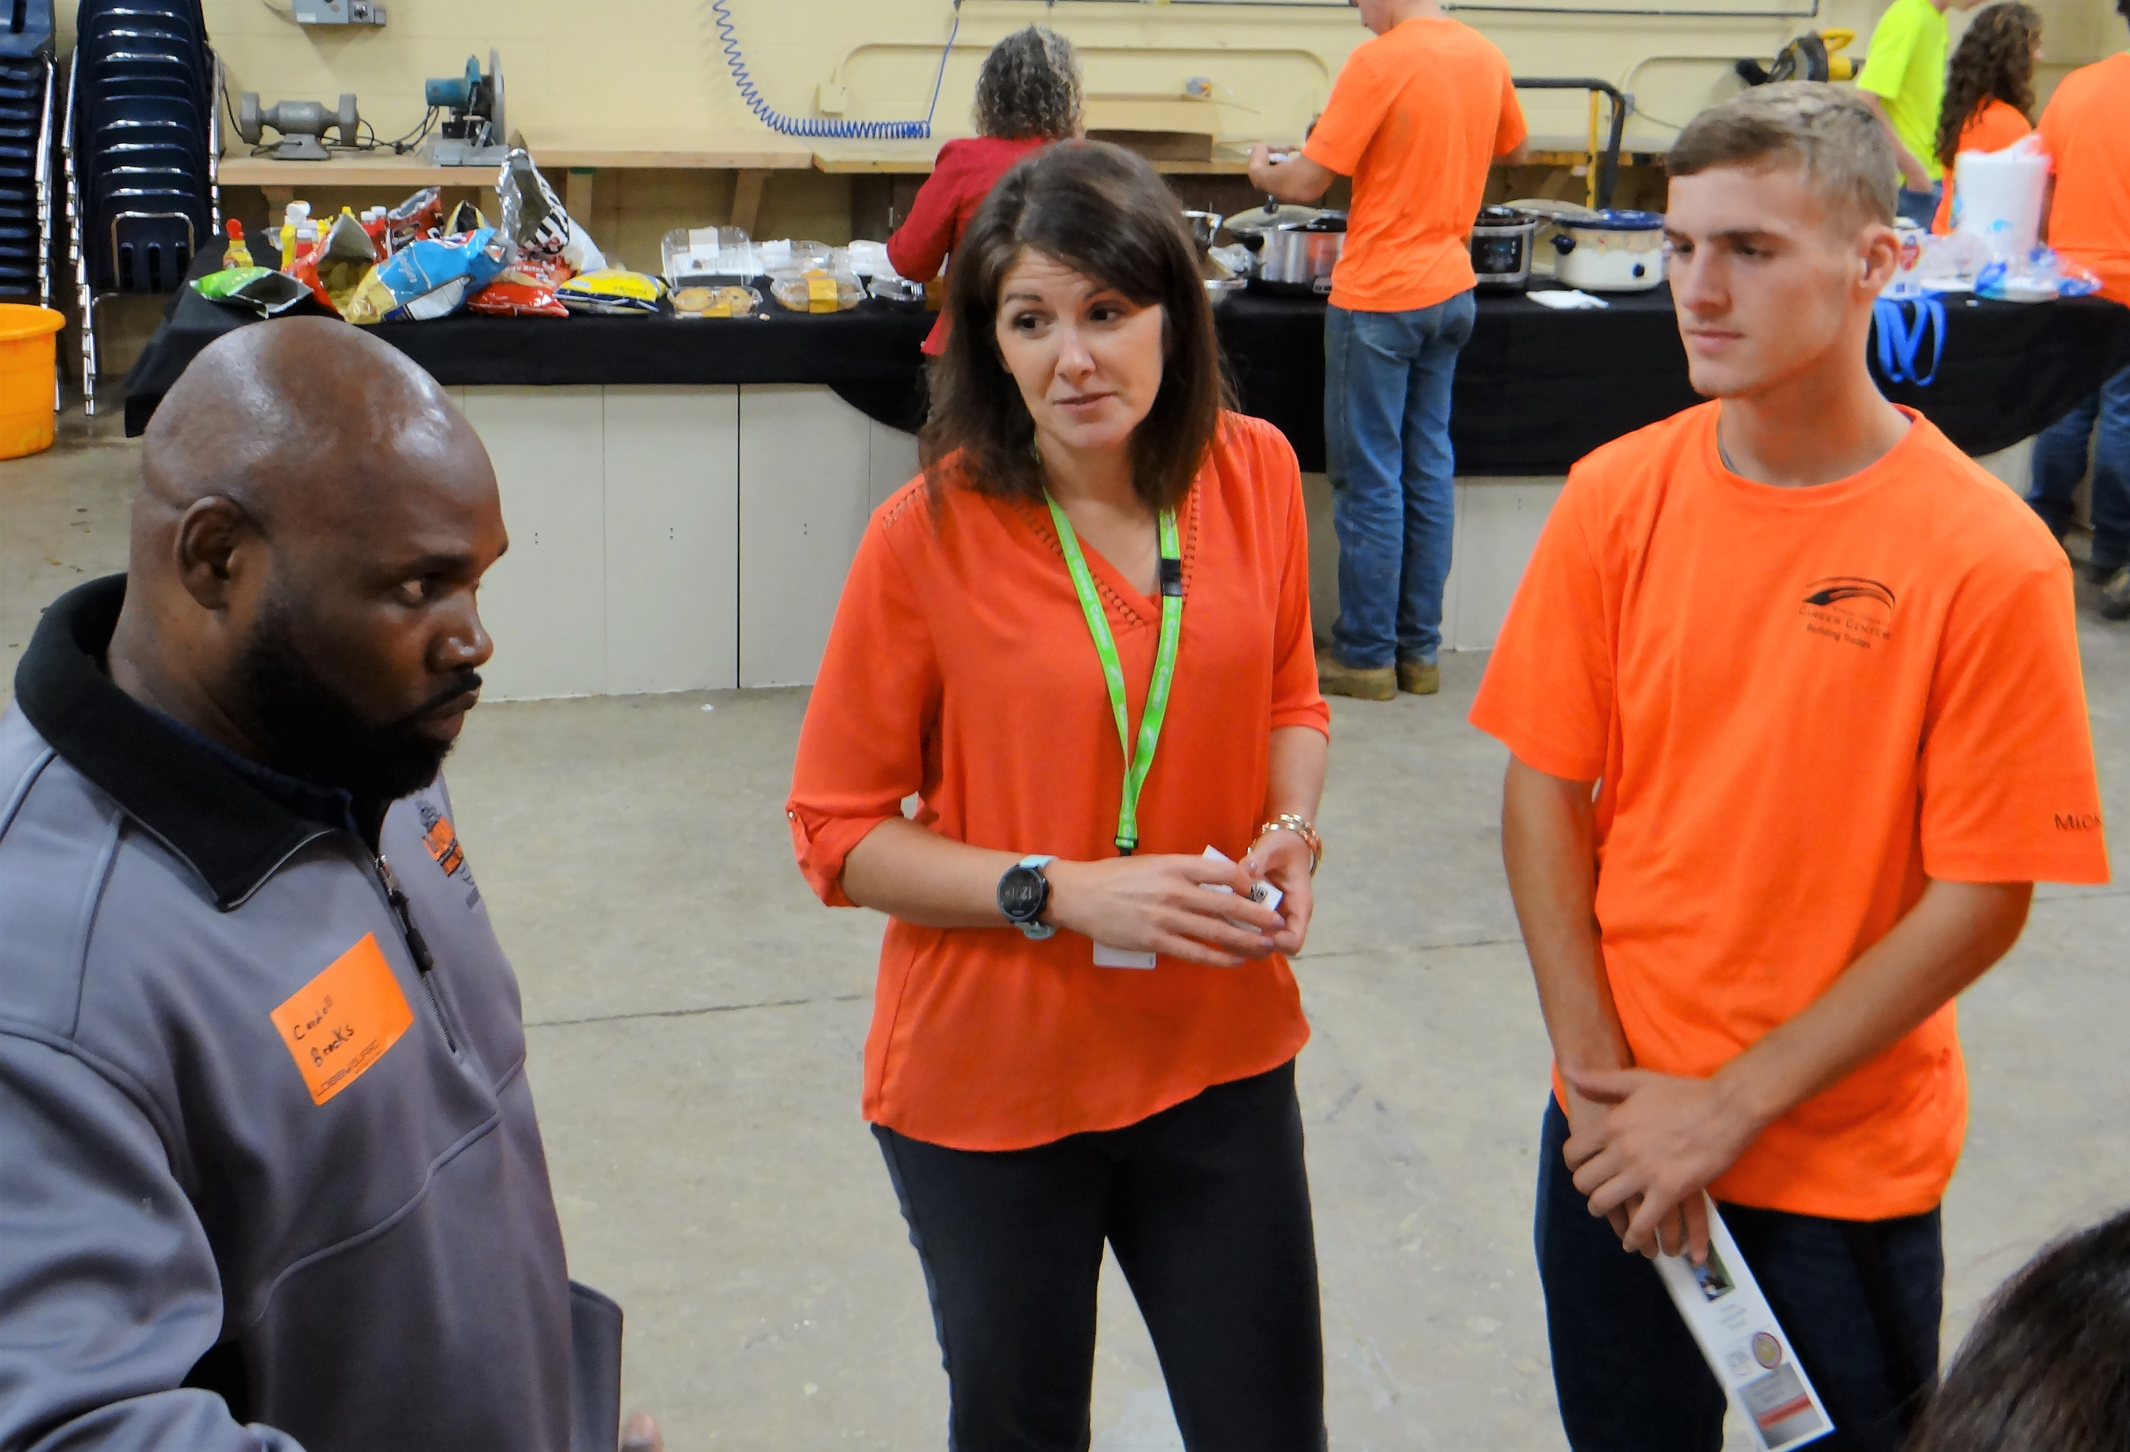

Slide 10
Hiring
Initial contact should be with the Instructor
First interview should be at the school
Second Interview should be at workplace
Keep the Instructor in the loop
Signing Day
Follow through

Slide 11
Mentoring
Formal mentorships typically fail
No mentorship will always fail

Slide 12
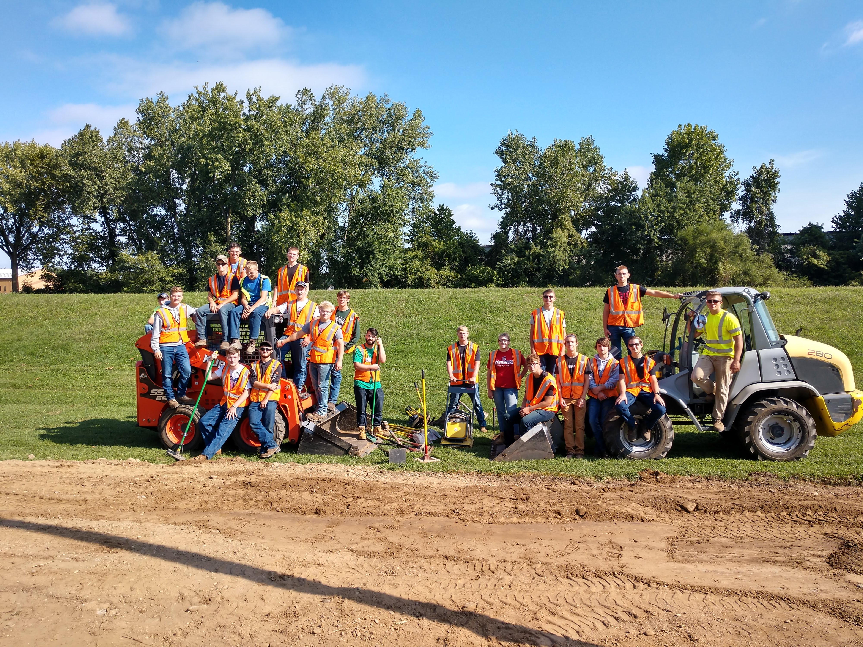
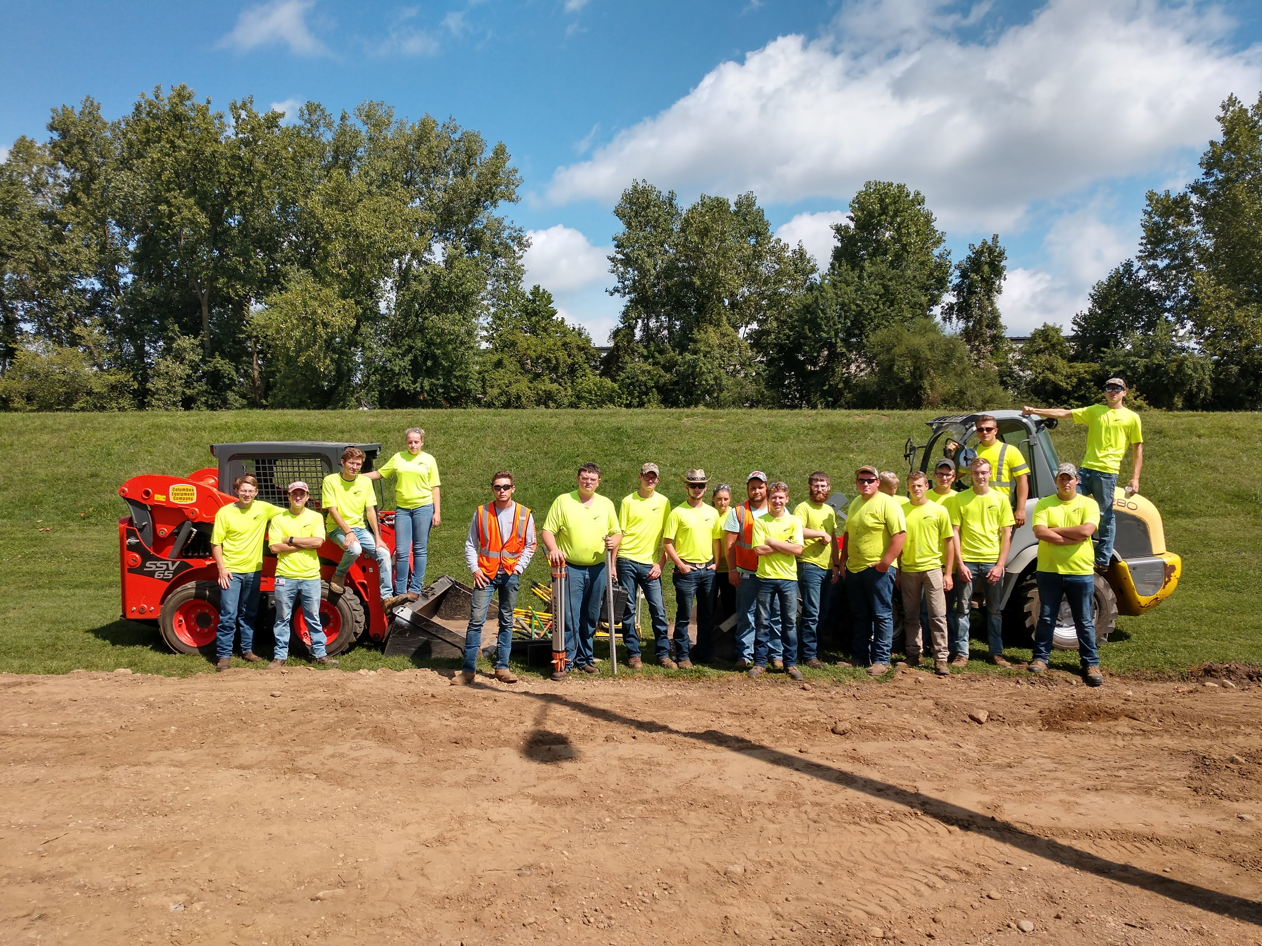

Slide 13
It is not the strongest of the species that survives, nor the most intelligent that survives. It is the one that is most adaptable to change.
Charles Darwin

